Slide 1


Social Buzz Data Analysis

Slide 2


Today's agenda
Project recap
Problem
The Analytics team
Process
Insights
Summary
Notes:
“Hello everyone. Thank you for joining us today. I’m excited to present the findings of the Social Buzz data analysis. Throughout this presentation, we’ll walk through the main highlights of our project, focusing on how data can drive engagement and strategy for Social Buzz."

Slide 3

Project Recap: Social Buzz POC
Client: Social Buzz (Tech Unicorn) Duration: 3 Months Goal: Prepare for global scale and IPO readiness
Project Focus:
Big Data Audit
Evaluate & optimize data practices.
Present recommendations on big data management.
IPO Recommendations
Strategic guidance for IPO success.
Best practices and workshops.
Top 5 Content Categories Analysis
Analyze user reactions to identify the most popular content categories.
Project Recap
Key Deliverables:
Big Data Audit Report
IPO Preparation Guide
Top 5 Content Categories Analysis
Outcome:
Help Social Buzz optimize data infrastructure, prepare for IPO, and identify top content trends to support its rapid growth.
Notes:
"Our goal was to support Social Buzz, a tech unicorn, as it prepares for global scale and its upcoming IPO. Over the course of 3 months, we focused on three key areas: optimizing big data practices, providing strategic IPO guidance, and analyzing content to identify the most popular categories."
"The key deliverables were the Big Data Audit Report, IPO Preparation Guide, and Top 5 Content Categories Analysis."

Slide 4

Problem
Problem:
100,000+ posts per day on Social Buzz
36.5 million pieces of content per year
Challenge:
How to capitalize on this overwhelming amount of content?
Objective:
Analyze and identify Social Buzz’s top 5 most popular categories of content to enhance engagement and monetization strategies.
Notes:
"Social Buzz receives over 100,000 posts per day, resulting in an overwhelming 36.5 million posts per year. With such a massive volume of content, the main challenge was identifying which categories drive the most engagement. Our objective was clear: analyze this data to find the top 5 most popular content categories and offer strategies to capitalize on them."

Slide 5


Andrew Fleming
Chief Technical Architect
Marcus Rompton
The Analytics team
Senior Principle
Nicola Francesco Mancini
Data Analyst
Michelle Grove
Data Scientist
Notes:
"Let me briefly introduce the team behind this project. Andrew Fleming, our Chief Technical Architect; Marcus Rompton, Senior Principal; Michelle Grove, Data Scientist; and myself, Nicola Francesco Mancini, as Data Analyst. Together, we collaborated to ensure accurate insights and actionable recommendations."

Slide 6
Data Understanding
Process
1
Data Cleaning
2
Data Modelling
3
Data Analysis
4
Key Findings
5
Notes:
"We structured our work into five key stages: first, data understanding, where we examined the dataset to grasp its structure and relevance. Next came data cleaning, ensuring that all entries were accurate and usable. In the third stage, we modeled the data, merging relevant fields. After that, we performed in-depth data analysis, and finally, we extracted key findings that were relevant to the client’s business goals."

Slide 7

Insights
The posts are about 16 different categories, and the most popular one in “animals”.
The reactions score of the most popular category “animal” is 14965; the total reactions are 1897.
May is the month in which people posted the highest amount of posts.
Notes:
"The data revealed 16 distinct content categories, with 'animals' being the most popular category. We also found that May had the highest number of posts throughout the year. The 'animals' category garnered the highest reaction score at 14,965, while the total reactions across all categories amounted to 1,897."

Slide 8
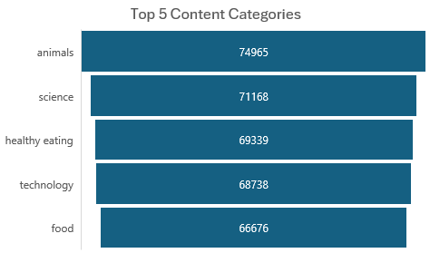
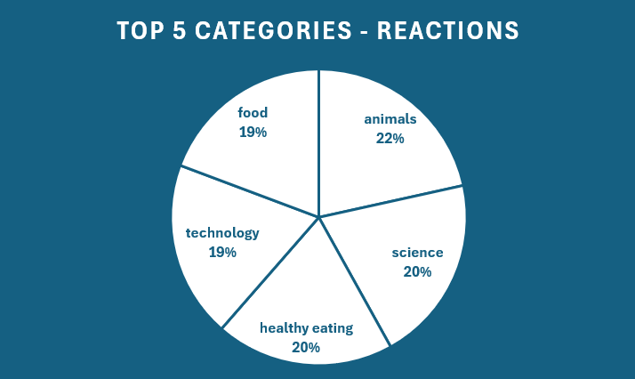
Out of 16 total categories, the ones in the graph are the top 5. On the left, is the total amount of reactions; on the right, the total score.
Notes:
"This chart shows the top 5 content categories based on total reactions. On the left, we see the number of reactions per category, and on the right, the overall score. Understanding these trends helps Social Buzz focus on the categories that generate the most engagement."

Slide 9
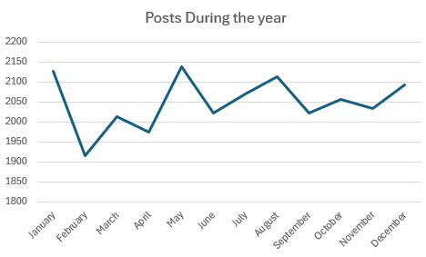
As this graph shows, May was the month with the highest amount of posts, followed by January and August
Notes:
"This graph highlights the posting trends throughout the year. As we can see, May was the most active month, followed by January and August. These insights can inform content scheduling and campaign strategies, ensuring peak user engagement."

Slide 10

Objective:
Identify key trends in user engagement and content performance to optimize Social Buzz's strategy in preparation for the IPO.
Summary
Key Findings:
Top 5 Content Categories;
Unique Categories;
Most Popular Category Reactions;
Month with Most Posts.
Outcome:
These insights will support Social Buzz in optimizing its content strategy and improving user engagement, important steps toward a successful IPO.
Notes:
"In summary, our analysis focused on identifying key trends in user engagement and content performance. We uncovered the top 5 content categories, highlighted the unique content available on Social Buzz, analyzed the most popular category reactions, and identified the month with the highest posting activity. These insights will be crucial as Social Buzz continues to optimize its content strategy and gears up for a successful IPO."

Slide 11
Thank you!
ANY QUESTIONS?
Notes:
"Thank you for your attention. Are there any questions? We’re happy to dive deeper into any of the insights or data."

